Slide 1
OUT OF REACH
DELAWARE
OFFICE OF THE CHILD ADVOCATE

Slide 2

OFFICE OF THE
ABOUT THE OCA
CHILD ADVOCATE
Safeguarding the welfare of Delaware’s children through educational advocacy, system reform, public awareness, training, and legal representation for children.
Policy and Training
Office of the Investigation Coordinator
Legal
Administration
Provides intensive reviews of serious child abuse cases, manages youth and transition programs, coordinates child welfare trainings, generates child welfare data and staffs the Child Protection Accountability Commission (CPAC).
Represents approximately 550 children that are experiencing foster care through appointment of Child Attorneys and Court Appointed Special Advocates with support from Program Coordinators.
Administrative support is provided to all divisions through leadership, managers, and support staff.
Monitors over 1200 serious child abuse cases and leads the multidisciplinary team case reviews.

Slide 3
The Problem
Children can be exposed to substances intentionally or through the reckless actions of a parent/caregiver.
261% Increase in reported cases of drug ingestions since the year 2020.
Pediatric drug exposures often result in serious physical injury and/or death.

Slide 4
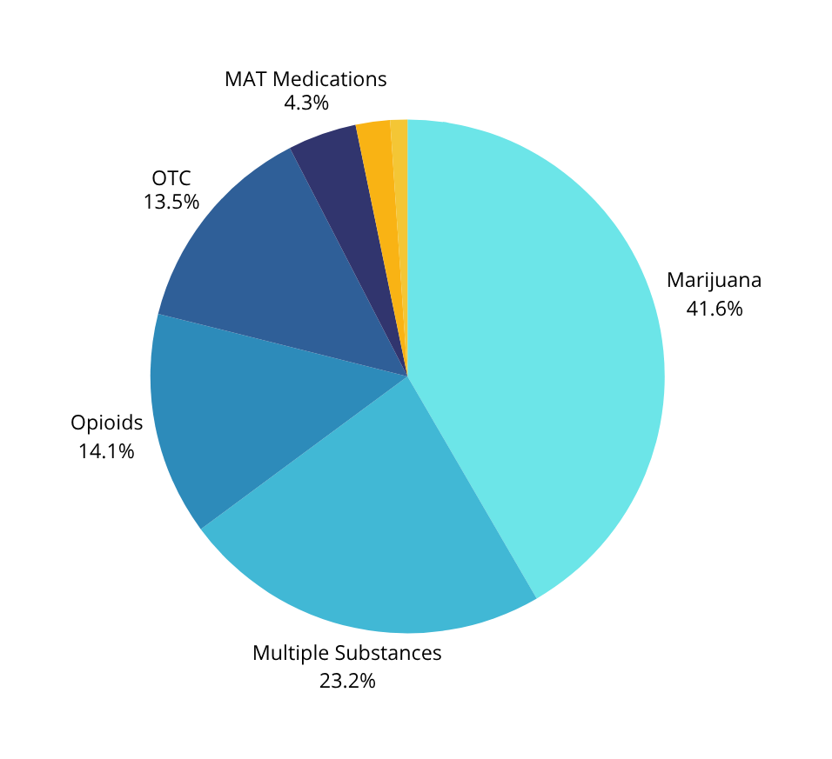
203
The Breakdown
Pediatric Drug
Exposures
and Ingestions
Marijuana
&
Fentanyl
3.3 Years
Average Age of a Child at the Time of the Ingestion
*Data from the Office of the Investigation Coordinator January 2021- December 2023

Slide 5

Out Of Reach
Delaware
Campaign focused on critical importance of child safety in relation to safe storage of prescription and recreational drugs
Created in collaboration with Drug Ingestion Workgroup and funded by Prescription Opioid Settlement Distribution Commission
Two prong approach to prevention -
  Educational Resources
  Intervention Tools

Slide 6
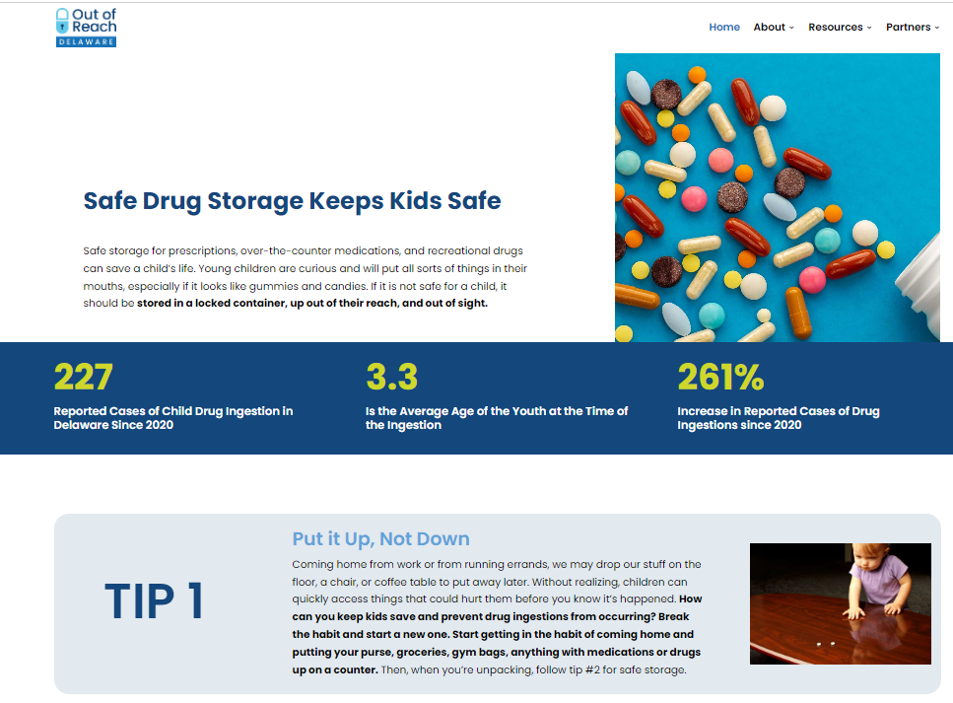
OUTOFREACHDE.COM

Slide 7

Go BLUE
B
Behind closed cabinents
L
Locked Away
U
Up and Out of Reach and Sight
E
Educate Others

Slide 8


What Have We Done?
Awareness
Intervention
Awareness campaign includes
  Statewide Billboards
  Shopping Mall Advertisements
  Social Media Campaign
  Launch of Website
Partnering with MAT programs to distribute medication lock boxes
315+
Lockboxes distributed
OutOfReachDe.com
With Resources
1.1M+
180+
Social Media
Impressions
Homes with
Children

Slide 9

Looking Ahead
Build Partnerships
  Distribute more lockboxes to community partners.
Provide Education
  Create educational training to be provided free on our website.
Keep Kids Safe
& Drugs Out of Reach

Slide 10
Out of Reach Delaware
THANK YOU
CARLEY.DAVIS@DELAWARE.GOV
OCA.TRAINING@DELAWARE.GOV
302-255-1744

