Slide 1
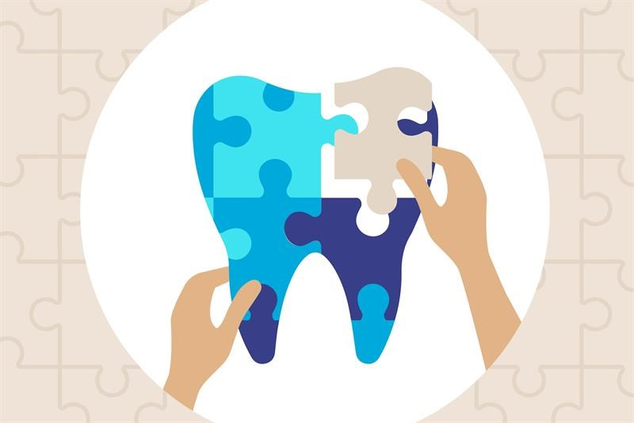
Bureau of
Oral Health & Dental Services
Delaware Division of Public Health
Department of Health & Social Services

Slide 2
Mission & Vision
  Promote and provide essential public health services to improve the oral health and well-being of all Delawareans.
  Vision: Delawareans will experience an enhanced quality of life through optimal oral health.

Slide 3
Goals
Support access to quality oral health services for disadvantaged families
Decrease the burden of oral disease through preventive services and oral health promotion
Develop infrastructure to support community-based public health initiatives
Protect overall health through advancements in oral health care

Slide 4
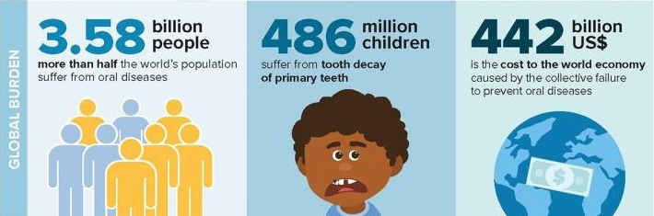
Oral Diseases are the Most prevalent diseases in the World
Dentistry Today March 2020

Slide 5
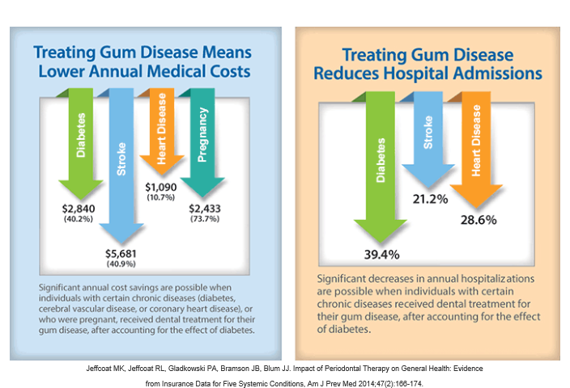
Affects health care costs and outcomes
Notes:
5

Slide 6

Health Inequity in Oral Health
The uninsured rate for dental insurance is four times higher than that for medical insurance.
Uninsured and publicly insured adults make up to 70% of all the 2.4 million ED visits each year for a dental problem
Traditional Medicare offers no dental coverage for the 37 million adults and people with disabilities it covers.
For low-income adults on Medicaid, it depends on where you live.
  11 states provide no dental benefits; 35 states limit coverage; and 19 states require a copay.
  Even for children with Medicaid or CHIP access is limited.
https://www.pcpcc.org/2021/03/30/pcc%E2%80%99s-new-report-highlights-deepening-national-crisis-access-oral-health-care-presents
Notes:
Primary care collaborative
The reports curates extensive data on barriers to oral health care including these key findings:
The uninsured rate for dental insurance is four times higher than that for medical insurance.
Uninsured and publicly insured adults make up to 70% of all the 2.4 million emergency department visits each year for a dental problem, and in many cases these are preventable.
Traditional Medicare offers no dental coverage for the 37 million adults and people with disabilities it covers.
For low-income adults on Medicaid, it depends on where you live.
11 states provide no dental benefits; 35 states limit coverage; and 19 states require a copay. Even when dental coverage is provided, as for low-income children who receive insurance through Medicaid or the Children’s Health Insurance Program (CHIP), access is limited.

Slide 7
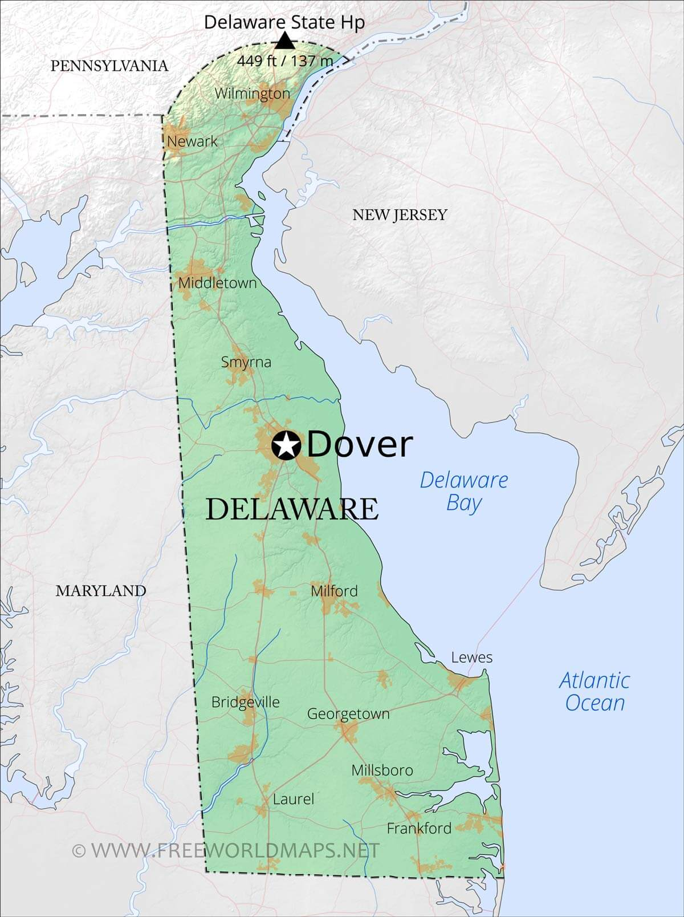
Delaware Access to Dental Care
178,000 live in a dental shortage area
  Nearly one-fifth of Delawareans do not have access to adequate dental care
Kent and Sussex Counties are Dental HPSA, as well as portions of New Castle County
An estimated 56 dentists would be required to eliminate the DE dental HPSA
2022 Legislation SB277 – Increase dental access by changing licensing restrictions

Slide 8

Oral health, inflammation and disease
People with gum disease are 2x as likely to have heart disease
Increases the risk of stroke
Bacteria is released into blood stream, can add to clot formation
Chemicals released to fight bacteria add to plaque build up in the arteries
Endocarditis (bacteria from the mouth travels to the heart)
Diabetes and gum disease: A two-way street
Having diabetes increases risk for gum disease
Having gum disease makes diabetes worse
Harder to control blood sugar
Increases the risk for infection in the body
People with controlled gum disease better manage their diabetes
Premature birth/low birth weight
Rheumatoid Arthritis
The periodontal bacteria (in particular Porphyromonas Gingivalis) can enter the bloodstream, reach the placenta, and generate toxins inside the amniotic fluid that result in inflammation, potentially causing premature birth.
Several studies have shown the link between RA and periodontal disease.
Recent findings indicate that infection with P. gingivalis precedes RA and that the bacterium is a likely factor in the initiation and maintenance of the autoimmune inflammatory responses that occur in this disease.
Good oral health has proven to better manage RA in patients.

Slide 9
Developing research
Alzheimer’s
Presence of Porphyromonas gingivalis found in patients with dementia, the same bacteria associated with gum disease
Lung Disease
Pneumonia
Cancer
People with a history of periodontal (gum) disease were 43% more likely to develop esophageal cancer and 52% more likely to develop gastric (stomach) cancer compared with people whose gums were healthier.
Gum disease increases the risk of cognitive dysfunction
Significant cause of death in long term-term care facilities
COPD
Breathing bacteria in

Slide 10
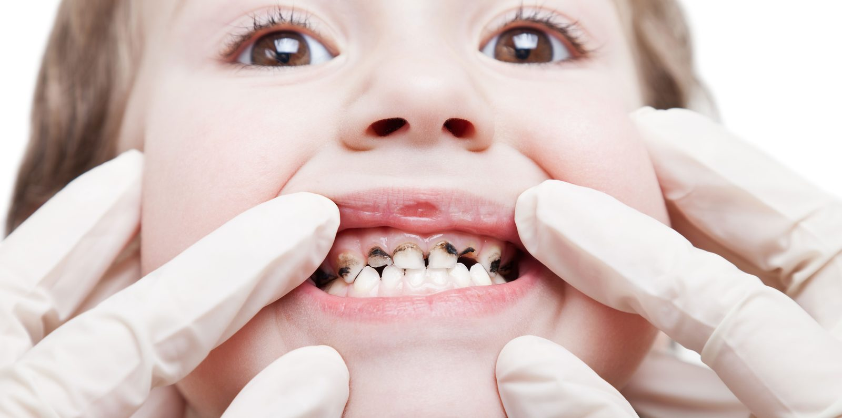
Prevalence of Disease
  Dental caries is the most common chronic disease of childhood
    1 in 5 children aged 5-11 years have at least one untreated decayed tooth
  Periodontitis (deep gum disease) affects almost 50% of U.S. adults
  58,450 oral cancers will be diagnosed in 2024
    12,230 of those will die

Slide 11
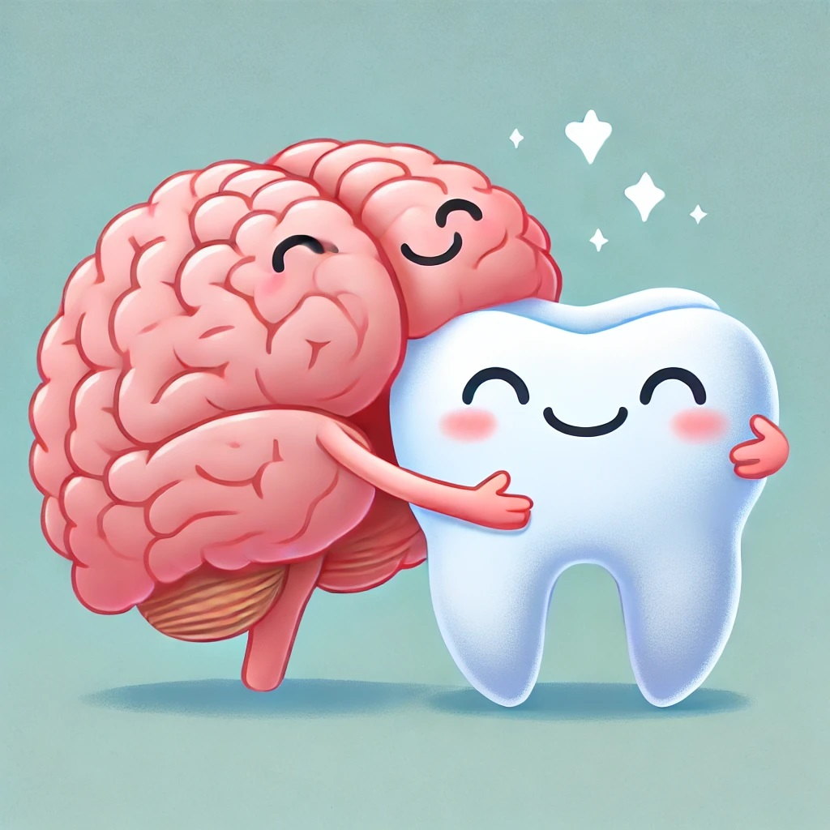
MENTAL HEALTH
Mental health and oral health are closely related.
Stress
Anxiety
Depression
Eating disorders
OCD
Studies show that people with mental health disorders are nearly 3x as likely to lose teeth.

Slide 12

How do we bridge the gap between underserved and access to care?
Clinical Services
    -Increasing access to care
Education
    -Increasing oral health literacy
Community Outreach
    -Increasing awareness and resources

Slide 13
Clinical Services
Kindergarten Screenings: Ensuring children are ready for school with healthy smiles.
Smile Check Program:
  Children: School-based, daycare centers, and community organizations.
  Adults: Flexible services available anywhere.
Warner School-Based Dental Clinic:
  Provides onsite preventive care (cleanings, exams, sealants, fluoride, SDF) for children attending Warner and Shortlidge schools.
Case Management:
  Comprehensive care management including counseling, referrals, and addressing barriers to care.

Slide 14
Education
Tailored oral health education for diverse groups:
  Women’s, men’s, and children’s oral health
  Special needs
  Prenatal/postnatal
  Seniors
  Oral-systemic health
  Dental integration into primary care
  Oral health with substance use disorder (SUD) focus
  Library partnerships focusing on literacy and early intervention
  Nurses
  Caregivers
  Train the trainer
Flexibility to create programs for any community partner’s needs, and present anywhere

Slide 15
Community Outreach
Partnership with Health 4 All, DOE, DE Libraries, DSAMH, grassroots
Participation in:
  Community resource fairs
  Fall festivals
  Back-to-school nights
  Open houses
  Any event that benefits the community
  Donations
Open invitation to partner organizations to invite us to their events

Slide 16

How can we help each other?
Encouraging collaboration to expand outreach
Identifying needs in your communities/clients/families you serve
Inviting the Bureau to attend relevant events
Know how to access and share the DE Dental Resource Guide (https://dhss.delaware.gov/dph/hsm/files/dentalresourceguide.pdf)
Know the Delaware Dental Helpline number: 302-318-8850

Slide 17

Thank you!
Gena Riley, RDH, CDHC
302-315-8853
Gena.riley1@delaware.gov
https://dhss.delaware.gov/dph/hsm/ohphome.html
Questions?

