Slide 1

Delaware Home Visiting
HV CAB · UPDATE
The Delaware Family Support Hub
From a specialist app to one connected home for the program.
Presented by Tapp Network · July 2026

Slide 2
WHERE WE'VE BEEN
An update since our last meeting
2019 – 2024
The Family Support Hub began as a custom app that helped Family Support Specialists get ready for home visits. Guides, resources, community organizations, and referral tools all lived together in one place.
A specialist app for home visit prep
SINCE Q2
Learning where the value really lives
Since we last met, our work has centered on a bigger question: what should this Hub become as the program grows? Here is what we learned, and where we are headed next.
NEXT
One unified, connected Hub

Slide 3
WHAT WE LEARNED FROM THE APP
The program showed us where the value really lives
Programs bring their own tools
Coordination is the shared need
Function is what matters most
Each home visiting model comes with systems built for how that program delivers care. A single specialist app sat on top of tools staff were already using.
What the program depends on is coordination: staffing, training, and the monthly numbers federal reporting requires, alongside trusted resources.
Specialists, supervisors, and families all gain when resources and community services are easy to find and simple to share.
So we evolved the Hub from one app into a single place that serves the public and the workforce, each with the access that fits their role.

Slide 4
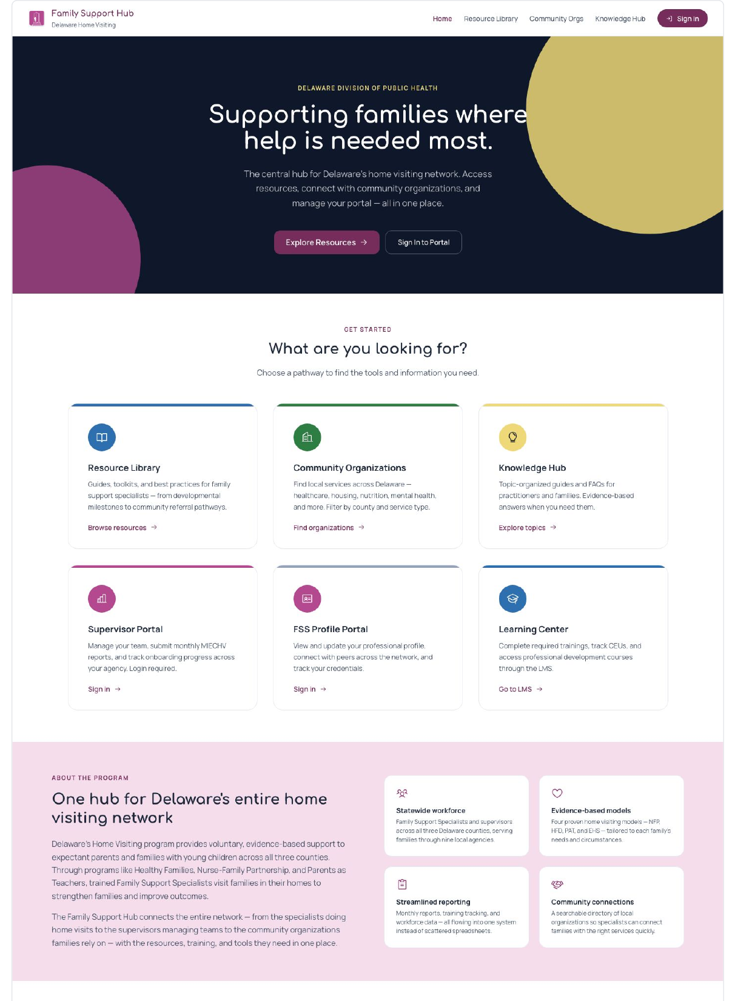
THE EVOLUTION
One connected home, with room to grow
✓
Same familiar front door
The Hub keeps its home at DelawareFamilySupportHub.org, so nothing feels unfamiliar.
✓
Expanded capabilities
More of what the program needs lives here now, with the Family Support Hub brand carried all the way through.
✓
Public and secure, together
Open information anyone can reach, plus secure portals for supervisors and specialists.

Slide 5
HOW IT FITS TOGETHER
A unified place, with permissions set accordingly
Everyone reaches the same Hub. What each person can open depends on who they are.
Open to everyone
Secured for the workforce
NO LOGIN · BARRIERS REMOVED
SIGN IN REQUIRED · ACCESS BY ROLE
Resource Library
Guides, toolkits, and best practices, open to all.
Supervisor Portal
Teams, onboarding, and monthly reports.
Community Organizations Index
A searchable statewide directory of services.
Family Support Specialist Portal
Profiles and peer connections across the network.
Events & Training calendar
What is coming up, visible to anyone.
Knowledge Hub
Organized guidance for the day to day work.

Slide 6
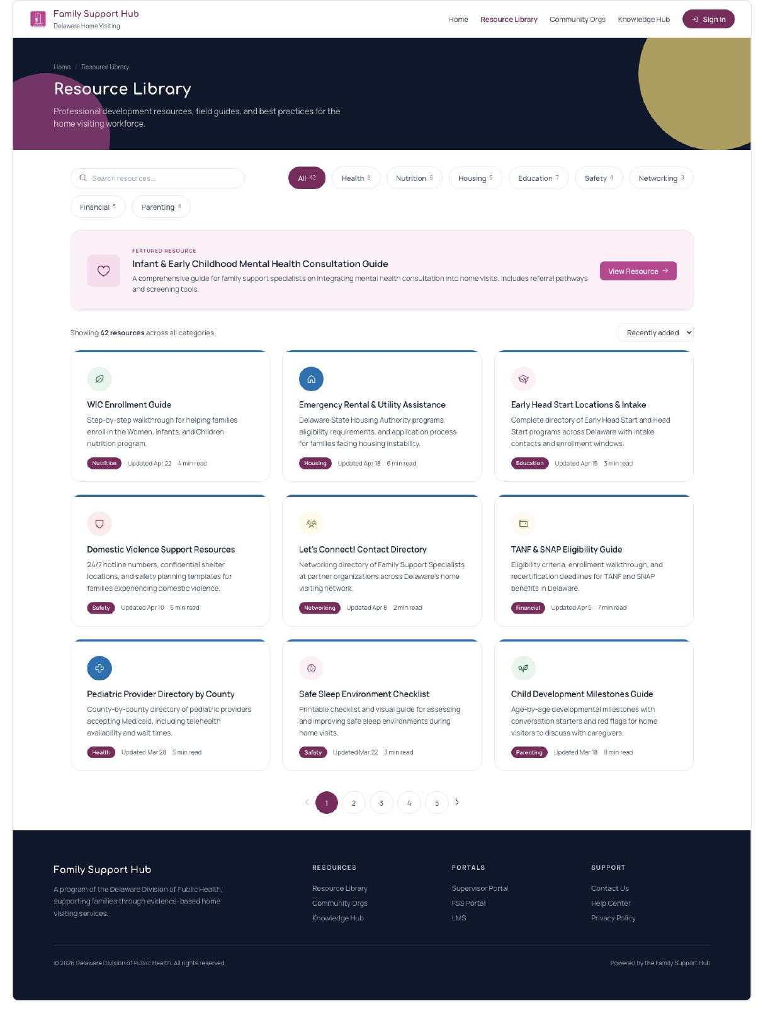
REMOVING BARRIERS TO ACCESS
The Resource Library & Community Organization Index is now public
Guides, toolkits, and best practices are open to anyone who needs them, with no account to create. Families, partners, and specialists reach the same trusted resources directly.
A searchable directory of the organizations serving Delaware families, open to all and filterable by county and service type. Connecting a family to the right service takes seconds.

Slide 7
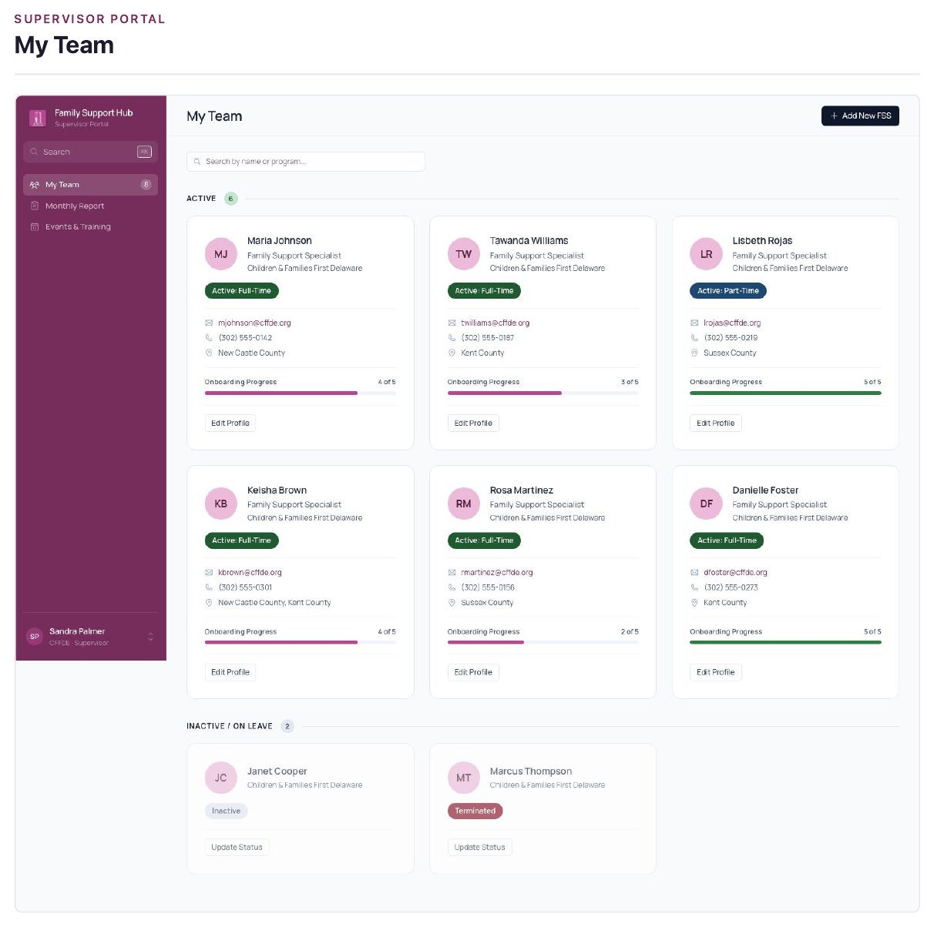
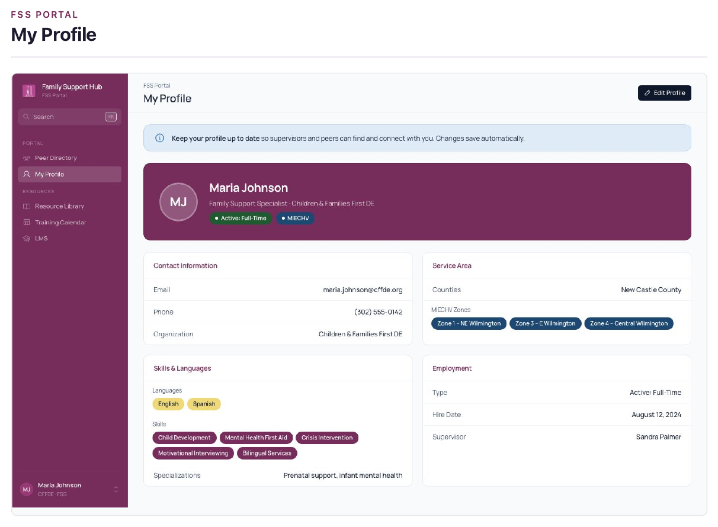
SECURED FOR THE WORKFORCE
Supervisors and specialists get their own tools
Supervisor Portal
Manage teams, track onboarding, and submit the monthly reports the program relies on.
Specialist Portal
Keep a profile current and connect with peers across the statewide network.
Knowledge Hub
Organized, evidence based guidance for the day to day work.
Each person sees what their role allows.

Slide 8
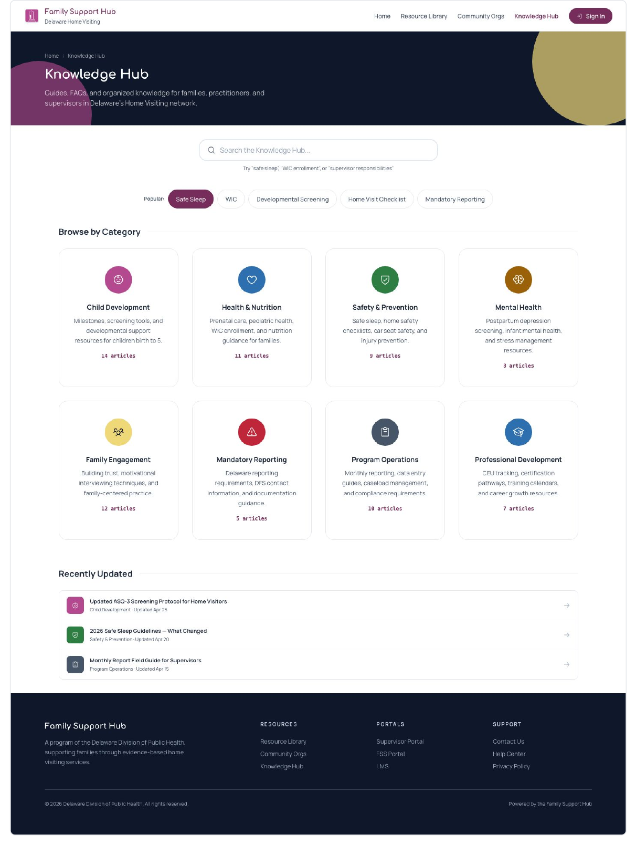
WHAT'S NEXT
What we're excited to bring
The unified Hub is the step we are building toward: one home for the Home Visiting program, public where it should be and secure where it needs to be.
One place for program information
Public resources and a public directory that remove barriers
Workforce tools connected to monthly reporting
A foundation that grows as the program adds services and families

Slide 9
Delaware Family Support Hub
Thank you
Questions and discussion welcome.
Tapp Network · Delaware Division of Public Health, Home Visiting Program

