Slide 1

Home Visiting Community Advisory Board
April 2026 Meeting
Wi-Fi Password:
PHLDO

Slide 2


Mission
Home Visiting Community Advisory Board (HV CAB)
Providers, policymakers, and other advocates, including numerous stakeholders, oversee the coordination of Home Visiting services within the early childhood system to ensure quality service delivery. HV CAB promotes a cross-sector collaboration among relevant state and community-based organizations to reduce duplication and advance common goals.

Slide 3
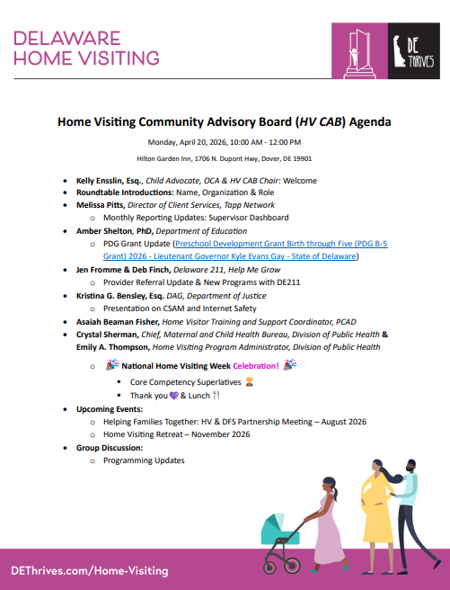
Today’s Agenda:

Slide 4
Welcome
Kelly Ensslin, Esq.
Child Advocate & HV CAB Chair
Office of the Child Advocate

Slide 5
Home Visiting Learning Management System & Delaware Family Support Hub
Melissa Pitts
Director of Client Services
Tapp Network

Slide 6


Slide 7

What We Heard & What We Did
Status of every item from the April 14 feedback
FEEDBACK
WHAT WE DID
Data lost if browser closes
Autosave + Save Draft button + Resume Draft banner
Cannot reopen submitted report to correct errors
Email corrections for now; post-submission editing on roadmap
Confirmation email/PDF not delivered
Fixed. Emails now send to submitter with PDF link
PDF emailed to wrong person (Melissa, not submitter)
Fixed. Contact association now links the actual submitter
Team needs notification emails
Crystal, Emily, Gary, Kayla, and Melissa now notified on every submission
Emails need View PDF / View in HubSpot buttons
Added both CTA buttons to notification email
PDF link not saved on record
pdf_url property now stored on every Monthly Report
PDF is blue instead of HV brand colors
Updated to purple (#B5498F)
Attachment limit too low (5)
Raised to 20
Need Funding Source column (MIECHV vs. State)
Dropdown added to staff table in Section 5
Need MIECHV virtual visits field
New field added to Section 1
Zone data errors on submission
Fixed. Zones are now flat properties (no separate objects)
New Directions Early Head Start as separate company
In progress. Creating separate HubSpot company record
Confidential | Tapp Network | TappNetwork.com

Slide 8
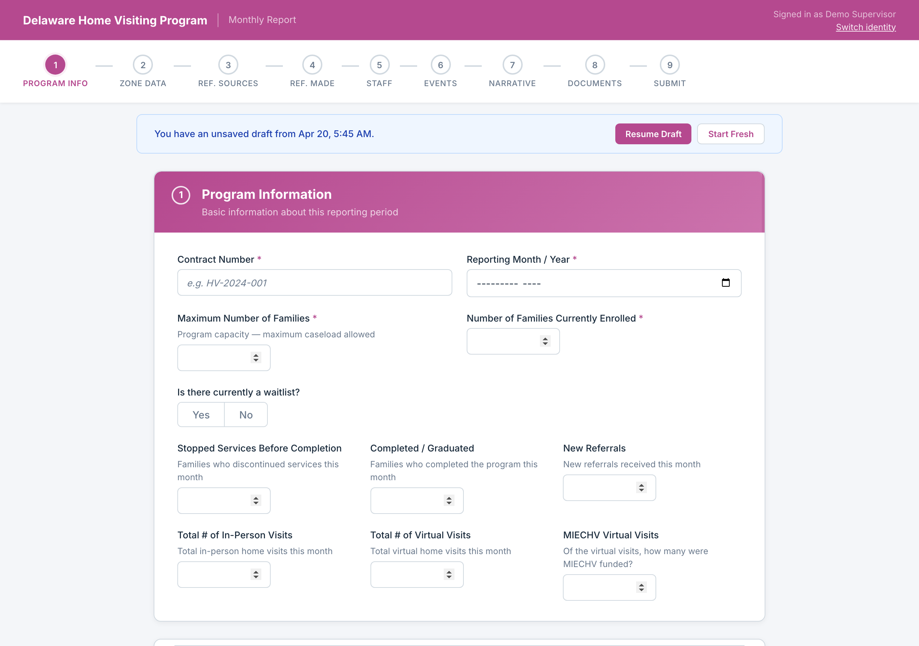
Autosave & Draft Restore
Your work is saved automatically. Resume where you left off.
Form auto-saves as you type. If you leave and come back, you can resume your draft or start fresh.
Confidential | Tapp Network | TappNetwork.com

Slide 9
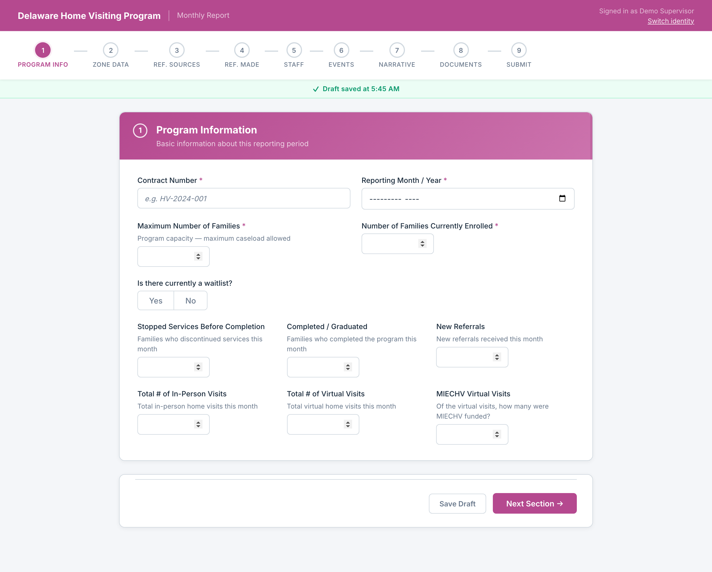
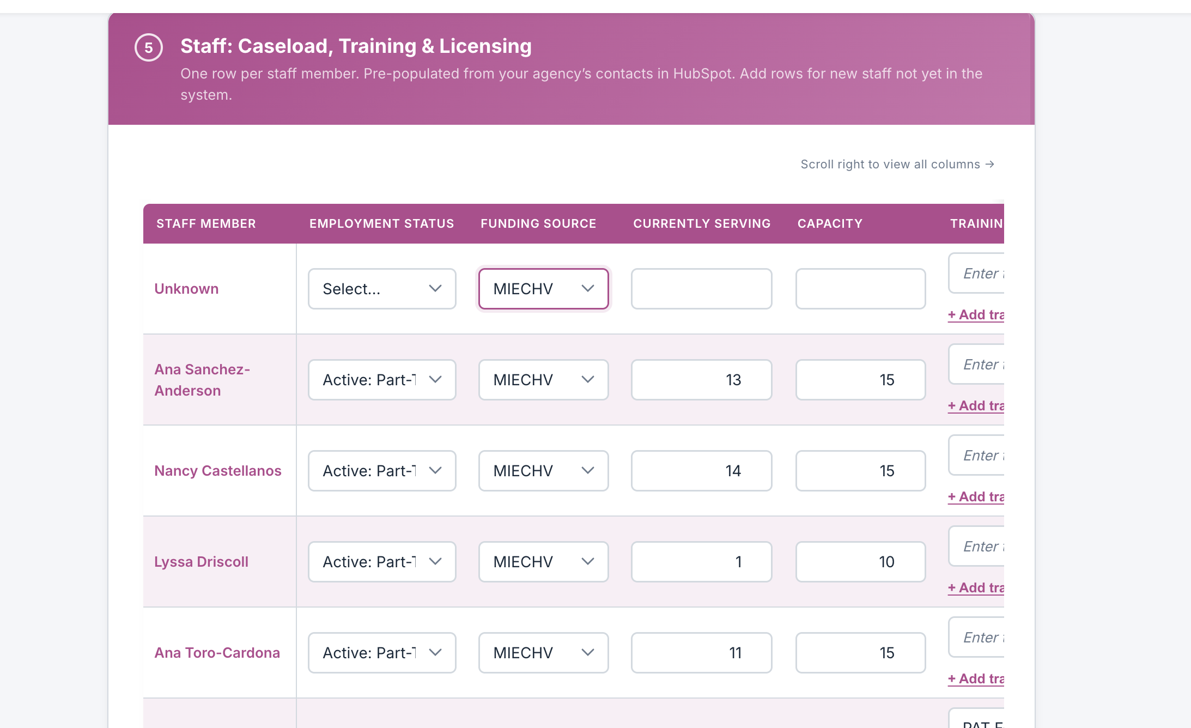
New: MIECHV vs. State Funding
Required data for funding sources has been added.
New "MIECHV Virtual Visits" field on Section 1. and ”Funding Source” selection in Section 5.
Confidential | Tapp Network | TappNetwork.com

Slide 10
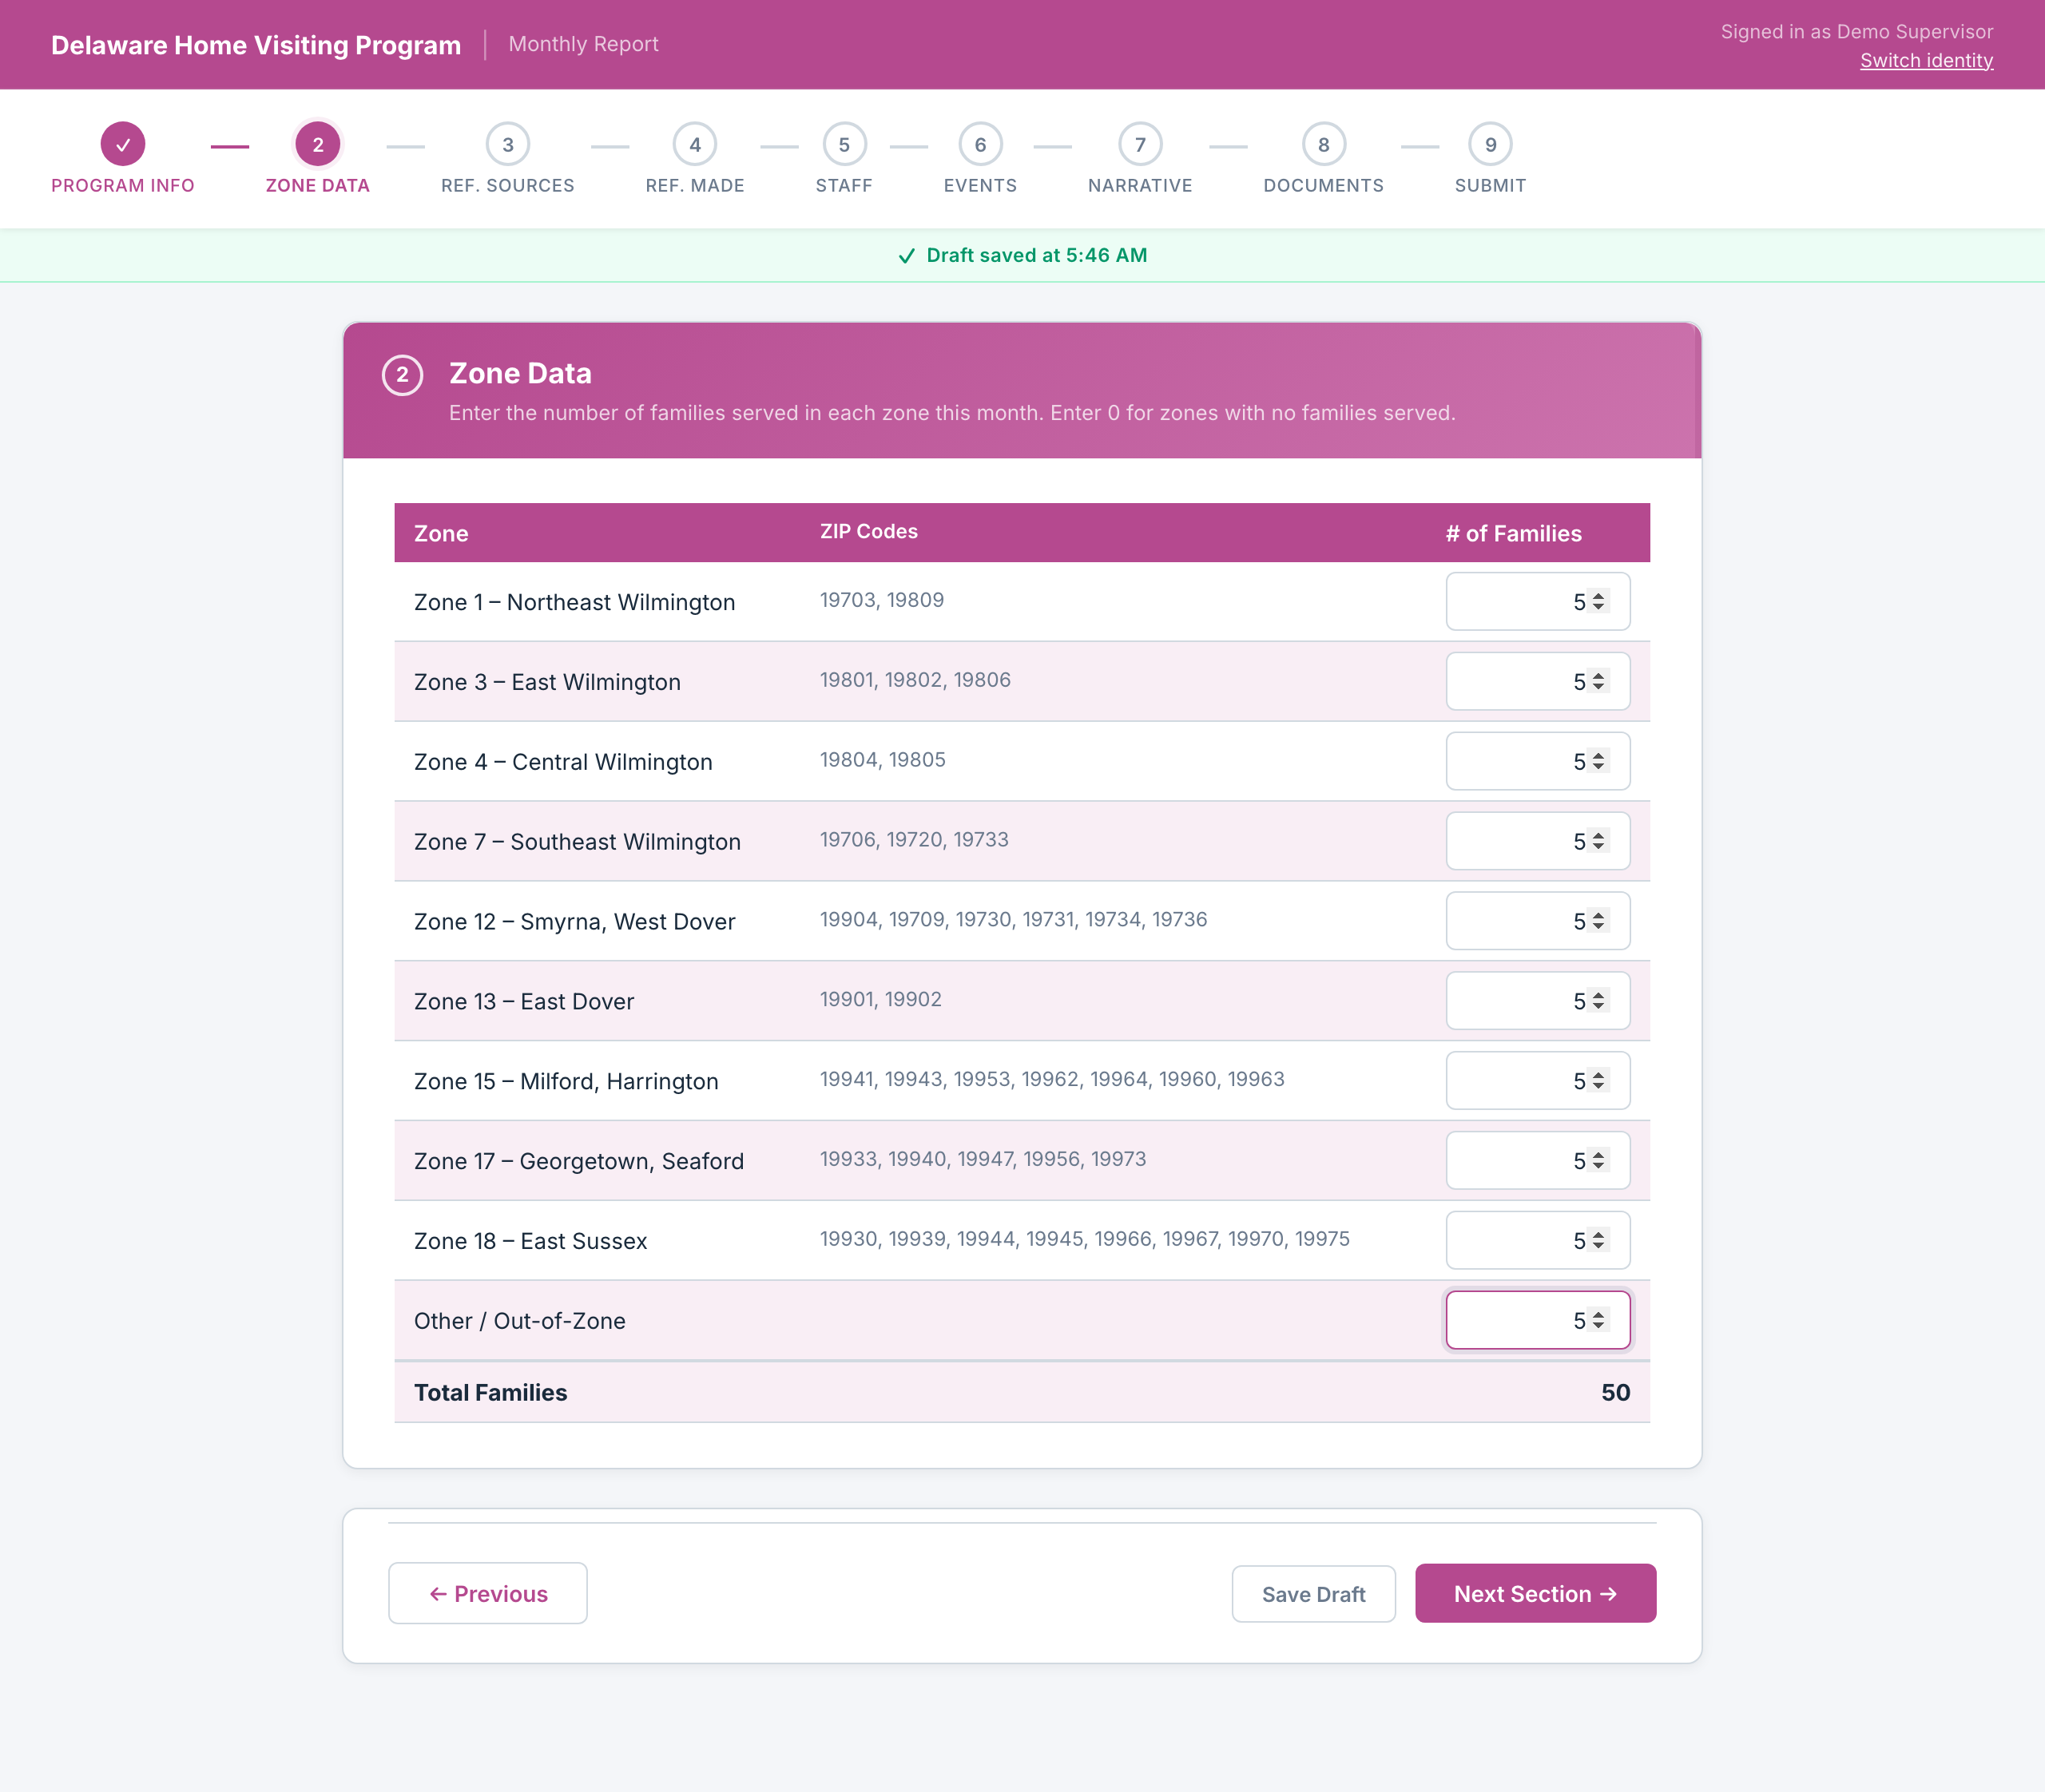
Zone Data: Fixed
Zone submission errors have been resolved
Zone data now saves as flat properties on the report record. The submission error is resolved.
Confidential | Tapp Network | TappNetwork.com

Slide 11
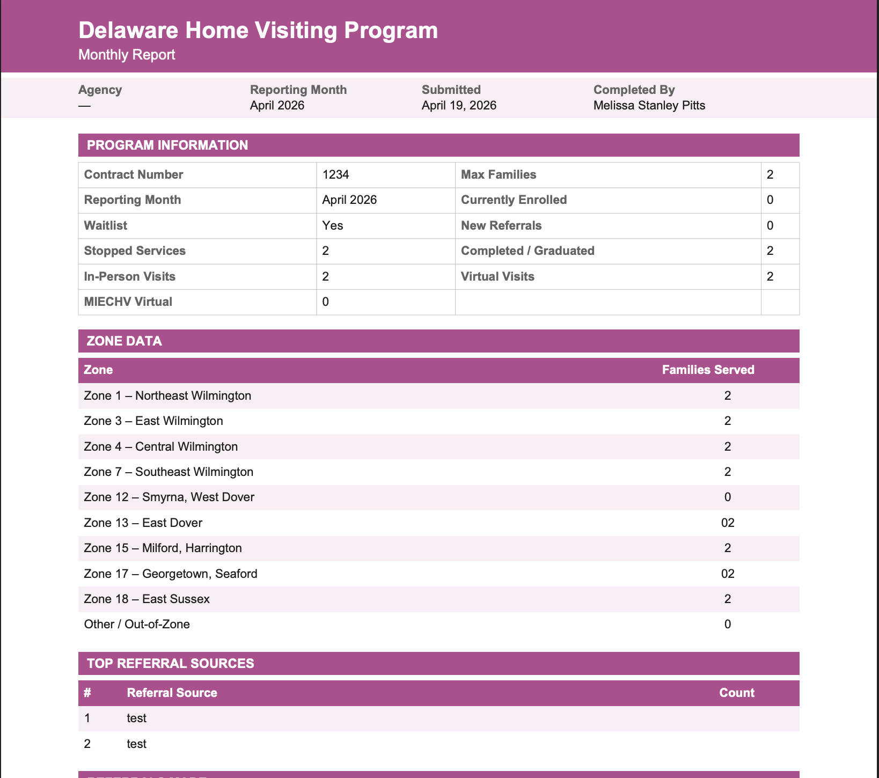
Submission & Email Notifications
Confirmation emails now go to the right people with the right links
• Confirmation email now sends to the person who submitted
• Email includes "View PDF" button
• PDF link is stored on the Monthly Report record in HubSpot
• PDF updated to Home Visiting purple branding
• File attachment limit raised from 5 to 20
Confidential | Tapp Network | TappNetwork.com

Slide 12
Amber Shelton
Department of Education
PDG Grant Update

Slide 13
Provider Referral Update & New Programs with DE211
Jen Fromme & Deb Finch
211/Help Me Grow

Slide 14
Presentation on CSAM &
Internet Safety
Kristina G. Bensley, Esq.
DAG, Department of Justice

Slide 15
Asaiah Beaman Fisher
Home Visiting Training and Support Coordinator
PCAD Updates

Slide 16
🎉NATIONAL HOME VISITING WEEK CELEBRATION🎉
Crystal Sherman &
Emily Thompson
Home Visiting Program, Division of Public Health

Slide 17
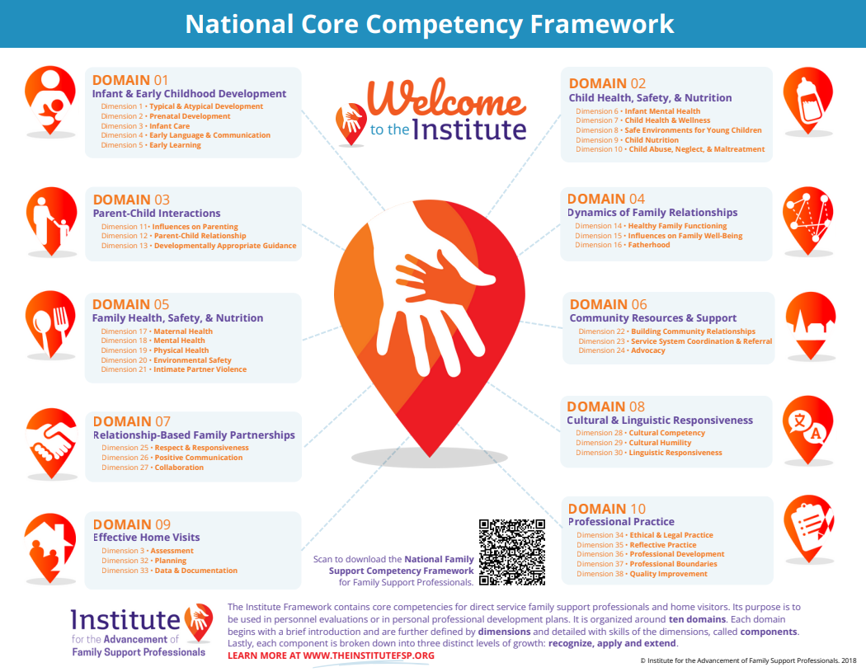
Core Competency Superlatives
Belineda Jones
Corsica Jones
Kesha Alston-Shields
Marisol Martinez
Sydney Ballenger
Tammy Broomall
Valerie Jolicoeur

Slide 18
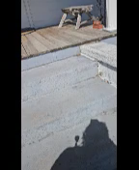

Slide 19
HV & DFS Partnership Meeting –
August 2026
HV Retreat – Novemeber 2026
Upcoming Events

Slide 20
2026
Home Visiting Community Advisory Board
(HV CAB) Meeting Dates
Monday, July 13, 2026
Monday, October 26, 2026
The meetings are held from 10:00 AM - 12:00 PM
with a light breakfast provided.
Hilton Garden Inn
1706 N. Dupont Hwy, Dover, DE 19901

Slide 21

Group Discussion

Slide 22
Thank you for attending!
Your dedication to your work makes a profound difference throughout Delaware.

