Slide 1

Supervisor Portal & Monthly Report Updates
Your Feedback, Our Updates
Delaware Home Visiting Program | HV CAB Meeting
April 20, 2026
Confidential | Tapp Network | TappNetwork.com

Slide 2
What We Heard & What We Did
Status of every item from the April 14 feedback
FEEDBACK
WHAT WE DID
Data lost if browser closes
Autosave + Save Draft button + Resume Draft banner
Cannot reopen submitted report to correct errors
Email corrections for now; post-submission editing on roadmap
Confirmation email/PDF not delivered
Fixed. Emails now send to submitter with PDF link
PDF emailed to wrong person (Melissa, not submitter)
Fixed. Contact association now links the actual submitter
Team needs notification emails
Crystal, Emily, Gary, Kayla, and Melissa now notified on every submission
Emails need View PDF / View in HubSpot buttons
Added both CTA buttons to notification email
PDF link not saved on record
pdf_url property now stored on every Monthly Report
PDF is blue instead of HV brand colors
Updated to purple (#B5498F)
Attachment limit too low (5)
Raised to 20
Need Funding Source column (MIECHV vs. State)
Dropdown added to staff table in Section 5
Need MIECHV virtual visits field
New field added to Section 1
Zone data errors on submission
Fixed. Zones are now flat properties (no separate objects)
New Directions Early Head Start as separate company
In progress. Creating separate HubSpot company record
Confidential | Tapp Network | TappNetwork.com

Slide 3
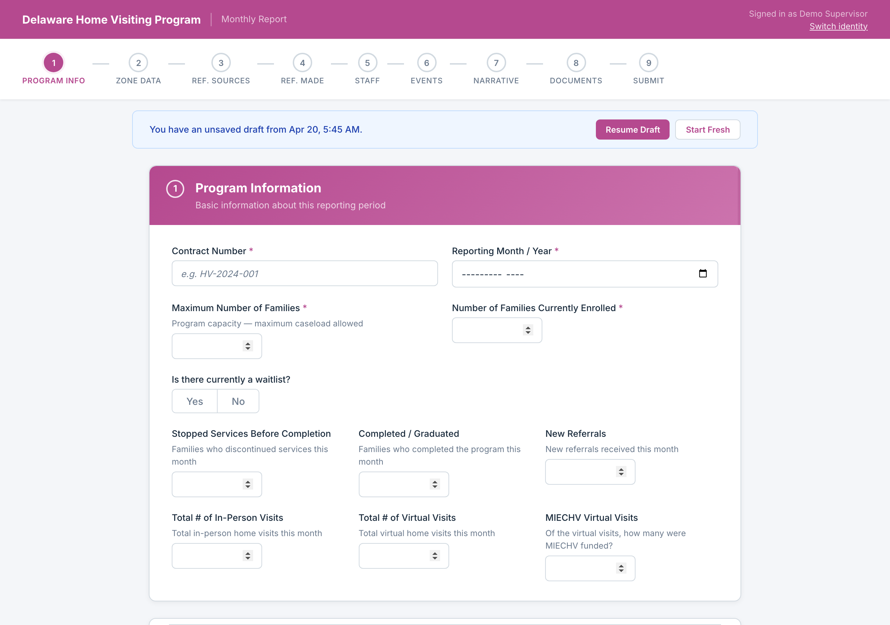
Autosave & Draft Restore
Your work is saved automatically. Resume where you left off.
Form auto-saves as you type. If you leave and come back, you can resume your draft or start fresh.
Confidential | Tapp Network | TappNetwork.com

Slide 4
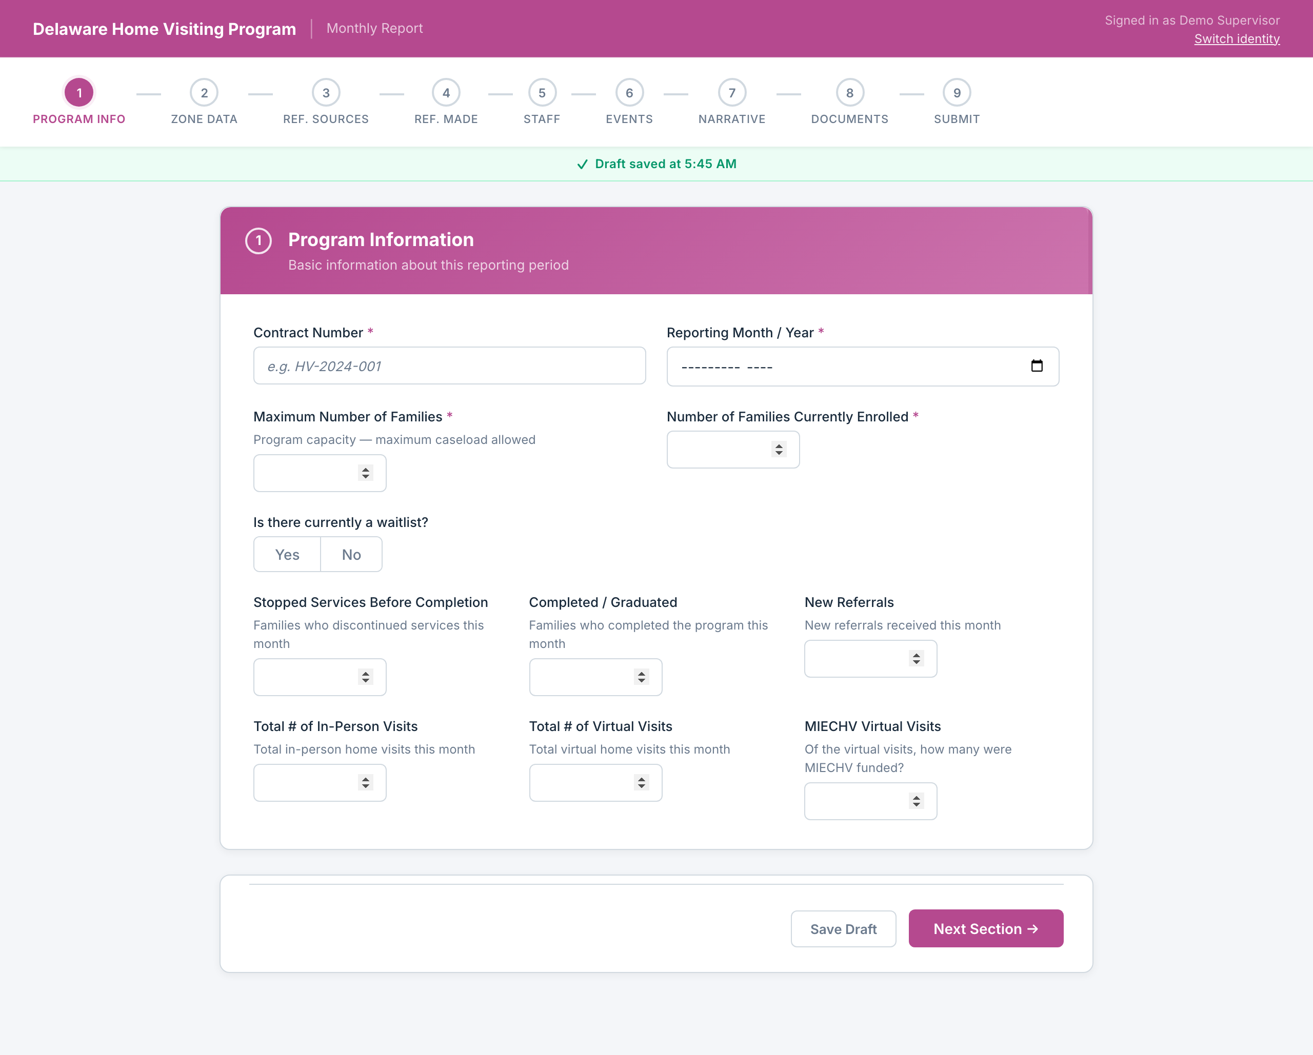
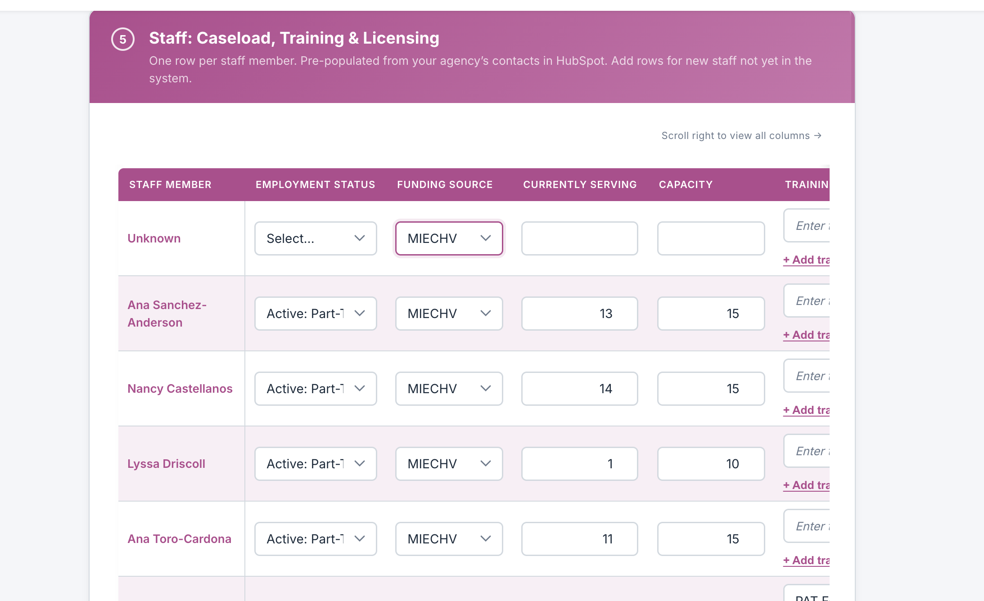
New: MIECHV vs. State Funding
Required data for funding sources has been added.
New "MIECHV Virtual Visits" field on Section 1. and ”Funding Source” selection in Section 5.
Confidential | Tapp Network | TappNetwork.com

Slide 5
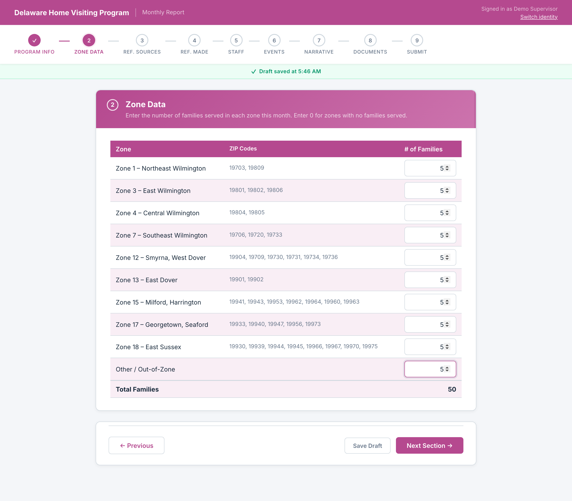
Zone Data: Fixed
Zone submission errors have been resolved
Zone data now saves as flat properties on the report record. The submission error is resolved.
Confidential | Tapp Network | TappNetwork.com

Slide 6
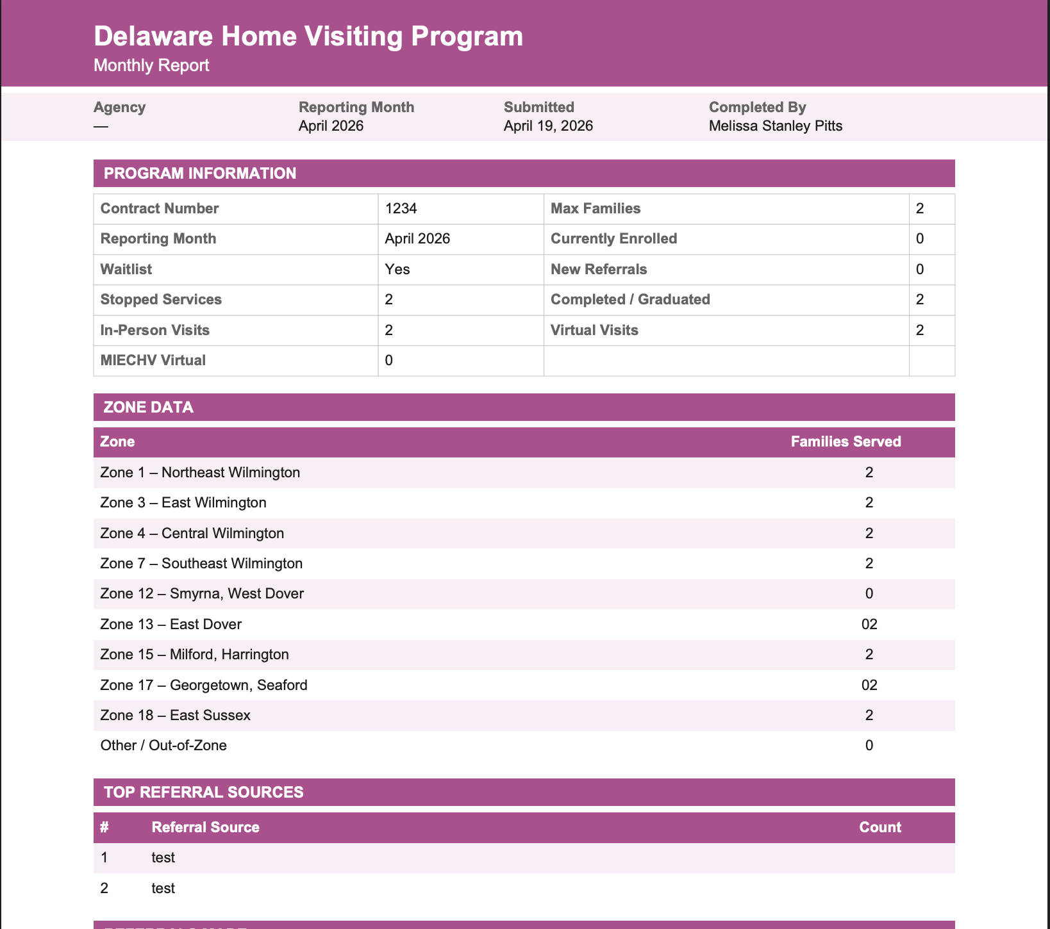
Submission & Email Notifications
Confirmation emails now go to the right people with the right links
• Confirmation email now sends to the person who submitted
• Email includes "View PDF" button
• PDF link is stored on the Monthly Report record in HubSpot
• PDF updated to Home Visiting purple branding
• File attachment limit raised from 5 to 20
Confidential | Tapp Network | TappNetwork.com

