Slide 1


Bureau Of Communicable Diseases
Division of Public Health
HIV Prevention Program
Nikita Clark (Niki)
Program Administrator
Health Promotion and Disease Prevention

Slide 2
Organizational Placement
Delaware Health and Social Services (DHSS)
Health Promotion Disease Promotion Section
Bureau of Communicable Disease
Division of Public Health
Section Chief: Helen Arthur
Bureau Chief: Bob Vella
HIV Prevention Program
HIV Surveillance Program
Administrator: Nikita Clark
Administrator: Charlene Rodriguez
Ryan White Program
Sexually Transmitted Infections Program
Administrator: Doug Trader
Administrator: Attillio Zarella
Delaware Division of Public Health • Bureau of Communicable Disease • HIV Prevention Program
2

Slide 3
HIV Prevention Program — Mission & Funding
Program Mission
Program Scale
Funded by the Centers for Disease Control and Prevention (CDC).
Promotes activities that prevent HIV acquisition, increase early diagnosis, and improve HIV treatment rates.
Approximately $1 million in annual CDC funding.
Supports comprehensive HIV prevention efforts throughout Delaware.
Four Pillars: Diagnose • Treat • Protect • Respond
DIAGNOSE
TREAT
PROTECT
RESPOND
Increase access to HIV testing and early diagnosis
Improve linkage to and engagement in HIV treatment
Promote prevention strategies such as PrEP and condoms
Support cluster detection, response, and partner services
Delaware Division of Public Health • Bureau of Communicable Disease • HIV Prevention Program
3

Slide 4
HIV Prevention Program Personnel
NC
RC
KL
Nikita Clark
nikita.clark@delaware.gov
Ray Collins
ray.collins@delaware.gov
Kayla Luke
kayla.luke@delaware.gov
Public Health Treatment Program Administrator
Social Service Administrator
Health Program Coordinator
Overall program leadership and oversight
Strategic planning, partnerships, grant management, and compliance
Statewide HIV prevention, testing, PrEP, and partner engagement
CBO contract and MOU oversight
Partner monitoring, technical assistance, and compliance
Rapid-test inventory/distribution coordination and harm-reduction collaboration
HIV prevention data and reporting support
CTR training and technical assistance
Data quality, reporting, and program coordination
Delaware Division of Public Health • Bureau of Communicable Disease • HIV Prevention Program
4

Slide 5
HIV Prevention Program Personnel
MP-M
SP
Maria Pena-Matos
maria.pena-matos@delware.gov
SaiTeja Paruchuri
saiteja.Paruchuri@delaware.gov
Health Program Representative
Health Program Coordinator
Condom Distribution/Tracking
Condom/Sex Material Inventory
Sussex County Site Visits
Rapid HIV Test Kits Orders
Test Tracking/Inventory
New Castle County Site Visits
Delaware Division of Public Health • Bureau of Communicable Disease • HIV Prevention Program
4

Slide 6
Program Objectives
1
Promote awareness and education about HIV transmission and prevention strategies.
2
Expand access to testing and counseling so individuals know their status and can take appropriate action, including linkage to care.
3
Support prevention initiatives, including pre-exposure prophylaxis (PrEP) and condom distribution.
4
Monitor data and trends to identify high-risk populations and tailor interventions effectively.
5
Support HIV cluster detection and response services.
6
Assign all new cases to Disease Intervention Specialists (DIS) for field interview and partner services follow-up.
Delaware Division of Public Health • Bureau of Communicable Disease • HIV Prevention Program
5

Slide 7
Core Program Responsibilities
Prevention Education & Outreach
Testing & Counseling
Provide HIV prevention education and community outreach.
Coordinate HIV testing services statewide and expand access to counseling, testing, and referral.
PrEP & Prevention Supplies
Training & Technical Assistance
Promote PrEP education/referrals and oversee condoms and HIV rapid-test inventory.
Coordinate CTR training and provide technical assistance to testing sites and partners.
Partnerships
Data & Compliance
Manage relationships with CBOs, healthcare providers, and community partners.
Monitor program performance, reporting, data quality, and CDC grant requirements.
Delaware Division of Public Health • Bureau of Communicable Disease • HIV Prevention Program
6

Slide 8
Community Partnerships & Service Network
Funded Community-Based Organizations (CBOs)
Memorandums of Understanding (MOUs)
Conexio Care: Harm Reduction & Prevention Supply Distribution
Delaware HIV Consortium: Harm Reduction & Prevention Supply Distribution
Beautiful Gate Outreach Center: HIV Testing Services
University of Delaware: HIV Testing Services
Latin American Community Center (LACC)
AIDS Delaware
Brandywine Counseling & Community Services
These CBOs deliver HIV prevention services throughout Delaware.
Partnership goal: expand prevention services, testing access, harm-reduction resources, and community reach.
Delaware Division of Public Health • Bureau of Communicable Disease • HIV Prevention Program
7

Slide 9
Needle/Syringe Exchange Program
Mobile harm-reduction services for active drug injectors residing within Delaware.
Service 1
Service 2
Provision of clean syringes through a 1-for-1 exchange to reduce risk of HIV, hepatitis, and other blood-borne infections.
Provision of HIV risk-reduction counseling and supplies.
Service 3
Service 4
Active referral to HIV, hepatitis, and substance-use treatment services.
HIV testing services for clients and residents of served communities.
Service 5
Service 6
Potential additions: pregnancy testing and hepatitis vaccination services.
Services are provided via mobile van.
Delaware Division of Public Health • Bureau of Communicable Disease • HIV Prevention Program
8

Slide 10
Related HIV & STI Programs
HIV Surveillance Program
Ryan White Program
STI Program
How We Connect
Administrator: Doug Trader
Federal program addressing gaps in care for persons living with HIV.
Funds primary health care and support services that increase access to and retention in care.
Serves as payer of last resort.
Administrator: Attillio Zarella
CDC-funded program providing statewide surveillance, education, and training for prevention and treatment of sexually transmitted infections.
Surveillance data informs prevention.
Prevention supports early diagnosis and linkage to care.
Ryan White supports access and retention in HIV care.
STI prevention complements HIV prevention efforts.
Administrator: Charlene Rodriguez
Conducts ongoing, systematic collection, analysis, interpretation, and dissemination of population-based HIV data.
Works with providers, hospitals, laboratories, and CBOs to monitor trends and disease burden.
HIV diagnoses are reportable under Delaware law and regulations.
Delaware Division of Public Health • Bureau of Communicable Disease • HIV Prevention Program
9

Slide 11
Prevention-to-Response Continuum
1
2
3
4
5
6
Educate
Test
Diagnose
Link
Protect
Respond
Identify new HIV diagnoses early
DIS assignment, field interview, partner services, and cluster response
Community outreach and HIV prevention education
Connect individuals to appropriate care and prevention services
Increase access to HIV testing and counseling
PrEP, condoms, harm reduction, and risk-reduction counseling
“Diagnose • Treat • Protect • Respond”
Delaware Division of Public Health • Bureau of Communicable Disease • HIV Prevention Program
10

Slide 12
CTR (Rapid HIV Testing) Training Eligibility
The State of Delaware HIV Prevention Program provides Counseling, Testing, and Referral (CTR) / Rapid HIV Testing training exclusively to organizations that have an active contractual relationship with the HIV Prevention Program.
Eligible Organizations Include:
Training Eligibility Requirement
Community-Based Organizations (CBOs)
Memorandum of Understanding (MOU) Partners
State-Operated Clinics
Title X School-Based Health Centers
CTR training is not provided to agencies or organizations that do not have a contractual relationship with the State of Delaware HIV Prevention Program.
This requirement ensures that CTR training and technical assistance are provided to organizations operating within the program's established service network and contractual framework.
Support for External Organizations
Although external organizations are not eligible to participate directly in the HIV Prevention Program's CTR training, the program is happy to provide information about available CTR/Rapid HIV Testing training opportunities.
This assistance may include directing external agencies to appropriate training resources or opportunities, as the program has done in the past.
Key Message:
CTR training is available to contracted HIV Prevention Program partners; external organizations may receive information and referral to appropriate training opportunities.
Delaware Division of Public Health • Bureau of Communicable Disease • HIV Prevention Program
8

Slide 13
Term | Meaning
HIV | Human Immunodeficiency Virus
AIDS | Acquired Immunodeficiency Syndrome
PrEP | Pre-Exposure Prophylaxis — medication taken to prevent HIV before exposure
PEP | Post-Exposure Prophylaxis — medication taken after a possible HIV exposure
ART | Antiretroviral Therapy — medication used to treat HIV
U=U | Undetectable = Untransmittable — a person with an undetectable viral load does not sexually transmit HIV
Viral Load | Amount of HIV in a person's blood
Viral Suppression | When HIV levels are reduced to a very low/undetectable level through treatment
HIV Testing | Testing to determine whether a person has HIV
CTR | Counseling, Testing, and Referral
Rapid HIV Testing | HIV testing that provides results quickly, often during the same visit

Slide 14
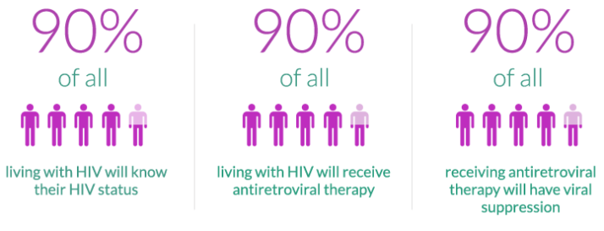
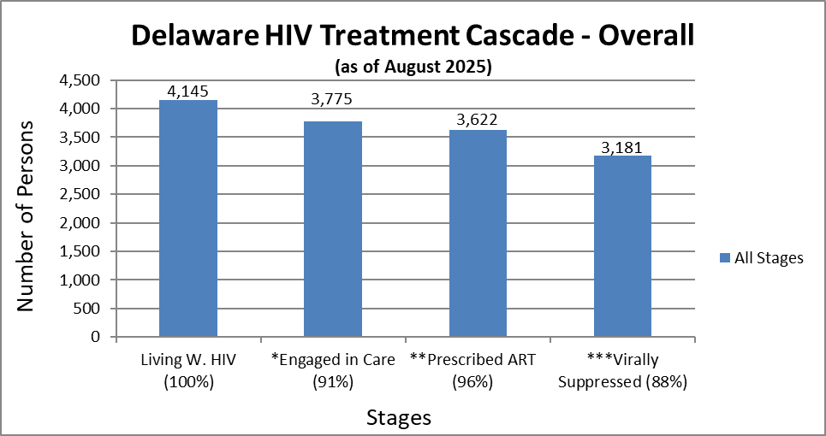
DELAWARE DPH HIV UPDATE
Data Retrieved August 2025
Notes:
Source: DE DHSS DPH 2022, Christiana Care Health Systems, CDC, Delaware Health Department Infectious Disease Clinic Survey, MMP 2015-2019 Interview Data.
*Percentage calculated from Living w. HIV **Percentage calculated from Engaged in Care ***Percentage calculated from prescribed art

Slide 15
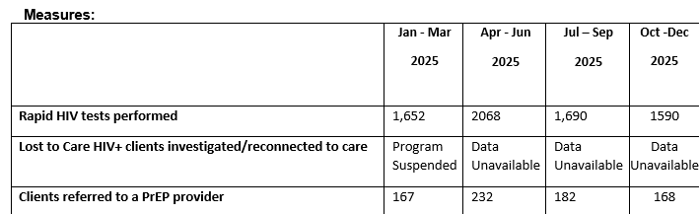
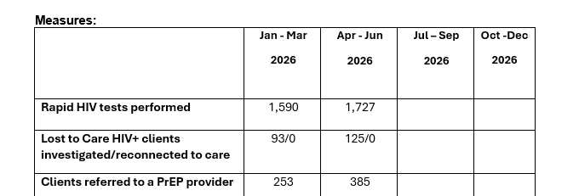
2025 Quarterly Data
2026 Quarterly Data
Of these, 16 individuals have been confirmed to be actively engaged in care, and 4 were determined to be HIV-negative and subsequently removed from the list.

Slide 16


STEP 2-PREPARE FOR AND CONDUCT THE HIV TEST
Explain the process of conducting the HIV test, including:
Type of test used
  The OraQuick ADVANCE™ Rapid HIV-1/2 Antibody Test detects antibodies to HIV-1 and HIV-2.
  Provides results in 20 minutes enabling patients to learn their status in a single visit.
  CLIA-waived for oral fluid, fingerstick and venipuncture whole blood.
  Ideal for both clinical and non-clinical settings.
Note: The rapid HIV test is a screening test. Confirmatory testing is always required with preliminary positive results.
Notes:
Our tests are a broad test that test for HIV 1 and 2 infection. It does not determine which strain the person has. We will use Chembio’s Sure Check most of the time
Remember: HIV takes 3 months to show up so depending on when the person was infected – we should recommend retesting
If there is an invalid test result – we will repeat the test immediately.

Slide 17
STEP 2-PREPARE FOR AND CONDUCT THE HIV TEST
Explain the meaning of non-reactive and reactive test results, including
Need for retesting if non-reactive “Window Period”
Need for conducting follow-up testing if reactive
Explain possibility of an invalid result

Slide 18
WINDOW PERIOD
Window period is the period between HIV infection and the time the body produces antibodies to HIV in sufficient quantities to be detected by an HIV antibody test
How you should explain to the client:
“The test may not pick up the infection if you were infected in the last 3 months. If you had unprotected sex or if you shared needles/works in the past 3 months, you will need to come back for follow up HIV testing in 3 months- even if today’s test is negative”.
“Since your last high-risk exposure was 5 days ago then I recommend you returning _________(90 days after last exposure), so we can test again because of a chance it’s too early for the test to detect a recent infection”.

Slide 19
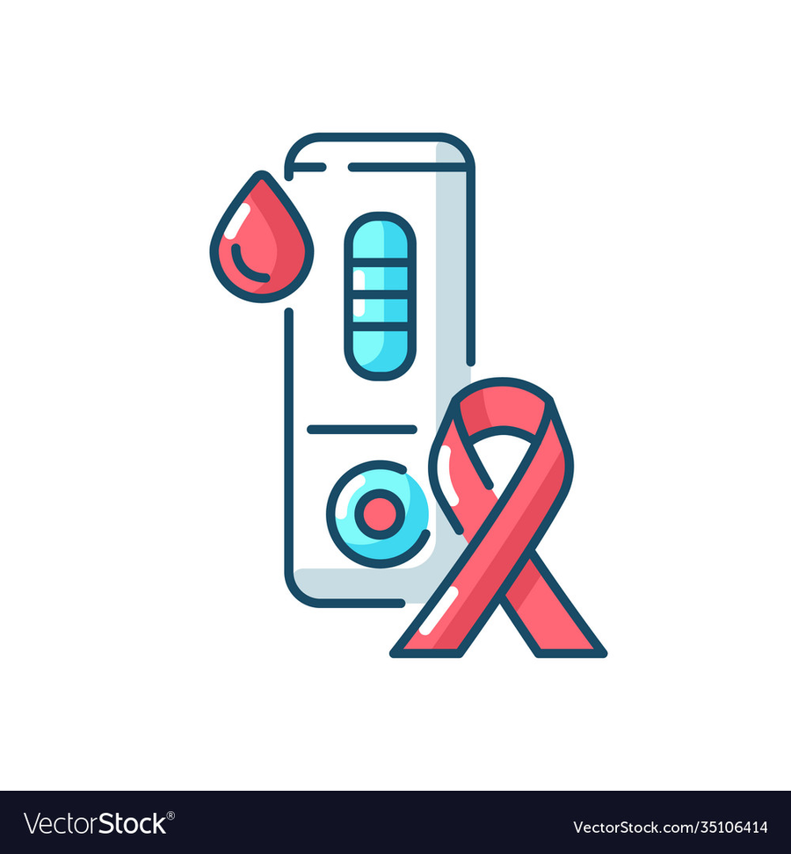
CDC RECOMMENDATIONS
As you are waiting for the test results your client may have questions about how often they should be tested:
CDC (Centers for Disease Control) recommends that all adolescents and adults, regardless of their risk factors get tested at least once for HIV as a routine part of medical care
Men who have sex with men (MSM) and others at high risk for HIV infection should be tested at least annually. However, it is suggested that:
High risk individuals may benefit from more frequent testing, every 3-6 months
Notes:
Discuss what is a Risk Form

Slide 20


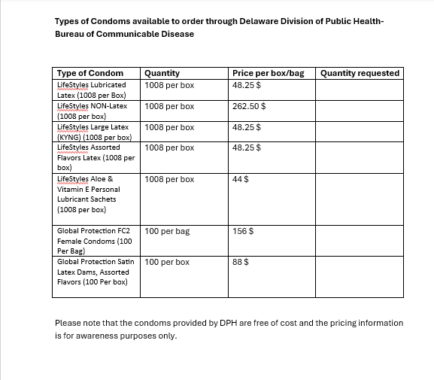



Condom Distribution
The HIV Prevention Program continues to support HIV and STI prevention efforts through the distribution of condoms to community partners, State Service Centers, and individuals at risk for HIV and other STIs. To date, the program has distributed 1,012 condoms, helping increase access to free prevention resources and promote safer sexual health practices throughout Delaware. Condom distribution remains an important component of the program’s comprehensive HIV prevention strategy, along with HIV testing, education, PrEP referrals, and community outreach.

Slide 21
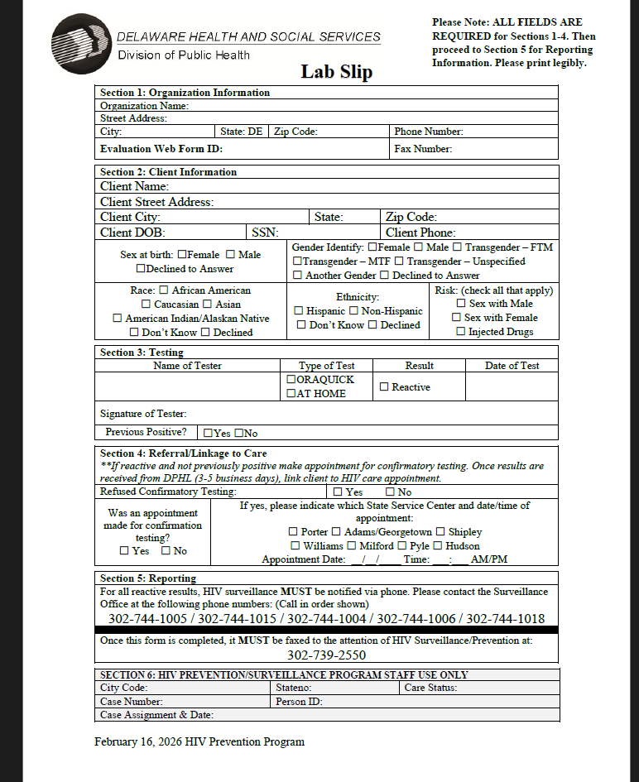
Fax: (302) 739-2550

Slide 22

FOLLOW THE DELAWARE DIVISION OF PUBLIC HEALTH HIV PREVENTION PROGRAM PROTOCOL:
CALL DPH SURVEILLANCE RIGHT AWAY TO REPORT A REACTIVE TEST

  Dawn Cirillo – HIV Surveillance
    Phone: 302-744-1005 Email: Dawn.Cirillo@Delaware.gov
  Malia Wise - HIV Surveillance
    Phone: 302-744-1015 Email: Malia.wise@delaware.gov
  Maria Uribe - HIV Surveillance
    Phone: 302-744-1004 Email: Maria.Uribe@delaware.gov
  Charlene Rodriguez – HIV Surveillance
    Phone: 302-744-1006 Email: Charlene.Rodriguez@Delaware.gov
  Kayla Luke – HIV Prevention Program Coordinator
    Phone: 302-744-1018 Email: Kayla.Luke@delaware.gov
In the event of a positive result on the weekend or after hours (8:00AM-4:30PM) please leave a voicemail with your name and number along with a message saying you have a reactive test to report and to give you a call back. Or send an email stating you have a reactive test to report. Please do not leave any patient identifying information on this message/email.
  Delaware Division of Public Health
  Thomas Collins Building
  540 S. DuPont Highway, Suite 12
  Dover, DE 19901
  Fax: (302) 739-2550
  You MUST call in the order shown to the right starting with Dawn to report an HIV positive result.

Slide 23
PARTNER SERVICES–
Disease Intervention Specialists (DIS)
Partner Services is implemented with all persons who test HIV-positive
Partner Services, Disease Intervention Specialists (DIS) are certified and have an in-depth counseling session with the client
Helps link clients with resources
Ensures client has no barriers to first clinical HIV appointment
Confidential elicitation/notification of partners
Offers partners testing, linkage to care, social/behavioral services
Local Health Departments play a key role in implementing Partner Services, and HIV testing providers (you) should be aware of the Partner Services in your county/state.

Slide 24
What is PrEP?
Pre-Exposure Prophylaxis (PrEP) is medication taken to prevent HIV.
When taken as prescribed, PrEP reduces the risk of getting HIV from sex by about 99%.
PrEP is recommended for individuals at increased risk for HIV.

Slide 25
Examples of Barriers to PrEP and HIV Prevention
Limited knowledge or misinformation about PrEP.
Stigma related to HIV, sexuality, or PrEP use.
Lack of health insurance or concerns about cost.
Transportation difficulties and limited access to providers.
Mental health challenges such as depression or anxiety.
Substance use disorders.
Fear of discrimination or lack of confidentiality.

Slide 26
PEP (Post-Exposure Prophylaxis)
PEP (Post-Exposure Prophylaxis) means taking medicine to prevent HIV after a possible exposure
You should take other actions to protect your partners while you are taking PEP. This includes always using condoms with sexual partners and not sharing needles, syringes, or other equipment to inject drugs
PEP should be used only in emergency situations and MUST be started within 72 hours after a recent possible exposure to HIV
The sooner you start PEP, the better. Every hour counts. If you’re prescribed PEP, you’ll need to take it daily for 28 days

Slide 27
When is PEP Used?
PEP may be used after:
Condomless sex or condom failure
Sexual assault
Needle sharing or injection drug exposure
Occupational exposure (healthcare settings)

Slide 28
STATE SERVICE CENTERS
New Castle County:
Winder Laird Porter State Service Center
509 W. 8th Street
Wilmington, DE 19801
(302) 777-2800
Floyd I. Hudson State Service Center
501 Ogletown Road
Newark, DE 19711
(302)-283-7500
Kent County:
Milford State Service Center
253 NE Front St.
Milford, DE 19963
(302) 424-7140
James W. Williams State Service Center
805 River Road
Dover, DE 19901
(302) 857-5150
Sussex County:
Thurman Adams State Service Center
546 S. Bedford St.
Georgetown, DE 10047
(302) 856-5241
Shipley State Service Center
350 Virginia Avenue
Seaford, DE 19973
(302) 628-6772
Edward W. Pyle State Service Center
34314 Pyle Center Road
Frankford, DE 19945
(302) 732-9512

Slide 29
What is Doxy-PEP?
Doxy-PEP (Doxycycline Post-Exposure Prophylaxis) is an antibiotic used after sex to reduce risk of certain bacterial STIs.
Taken within 72 hours after sex
Uses the antibiotic doxycycline
Helps prevent:
Syphilis
Chlamydia
(Some studies show reduced gonorrhea risk)

Slide 30
Who May Benefit from Doxy-PEP?
Currently recommended for:
Gay, bisexual, and other men who have sex with men (MSM)
Transgender women
Individuals with recent bacterial STIs
Used as part of a comprehensive sexual health plan

Slide 31
Team Collaboration & Impact
Program Administration
Contracts & Operations
Data & Training
Nikita Clark
Leadership and strategic direction
Grant management and compliance
Program planning and partnerships
Ray Collins
CBO and MOU oversight
Partner monitoring and technical assistance
Testing inventory and harm-reduction coordination
Kayla Luke
Evaluation/data support
CTR training coordination
Technical assistance and data quality
Together, the team strengthens Delaware’s HIV prevention system and advances statewide prevention goals.
Delaware Division of Public Health • Bureau of Communicable Disease • HIV Prevention Program
11

Slide 32


Slide 33
HIV Prevention Program
THANK YOU
ANY QUESTIONS!!
Prevent new HIV infections • Expand testing • Connect people to care • Protect communities • Respond to emerging needs
Nikita Clark
nikita.clark@delaware.gov
PH: 302-744-1016
HIV Prevention Program Administrator
Delaware Division of Public Health • Bureau of Communicable Disease • HIV Prevention Program
12

